Slide 1

YUMI
“The future starts where the youth begins”
Tech Jobs in Indiana Team 02
Team T-Tech
Pro Squad
Arnav Patel
Ibrahime Sow
Vinush Kumar
Tony Martin
Go Squad
Chinmayee Modak
Jasmine Abdullah
Drew Paxton
Notes:
MInority Teens lack resources , educational opportunities and support With the tec

Slide 2
Customer Persona
Lack of Resources
Fewer
Opportunities
Support
Minority Female
9-12th Grade
L Group1
9-10th grade
Educational
Blockage
Notes:
jasmine

Slide 3
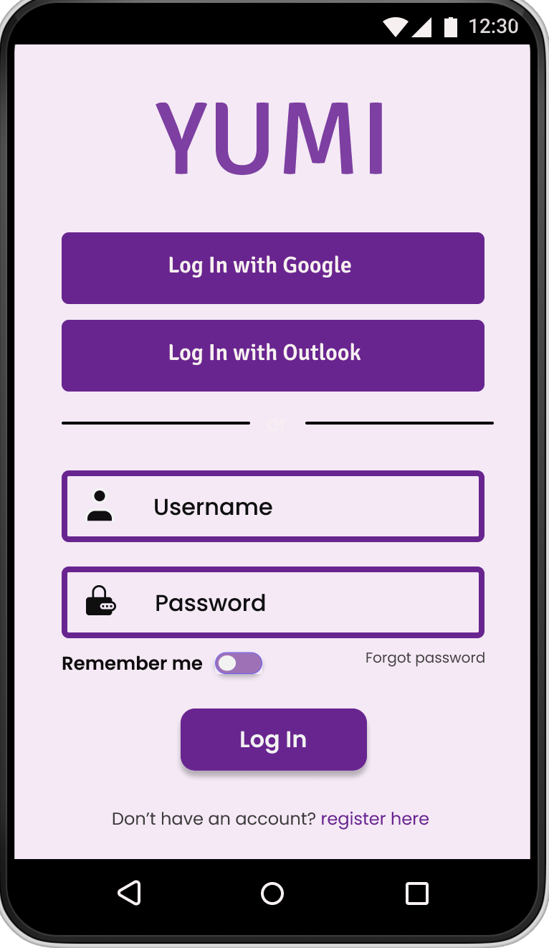
Solution
Partnerships
Challenges
Support
Resources
Notes:
jasmine

Slide 4
About YUMI
Grade 9&10:
Grade 11&12:
-Connection
-Friends
-Introduction
-Mentorship
-Internship
-In-depth Experience
Notes:
jasmine

Slide 5
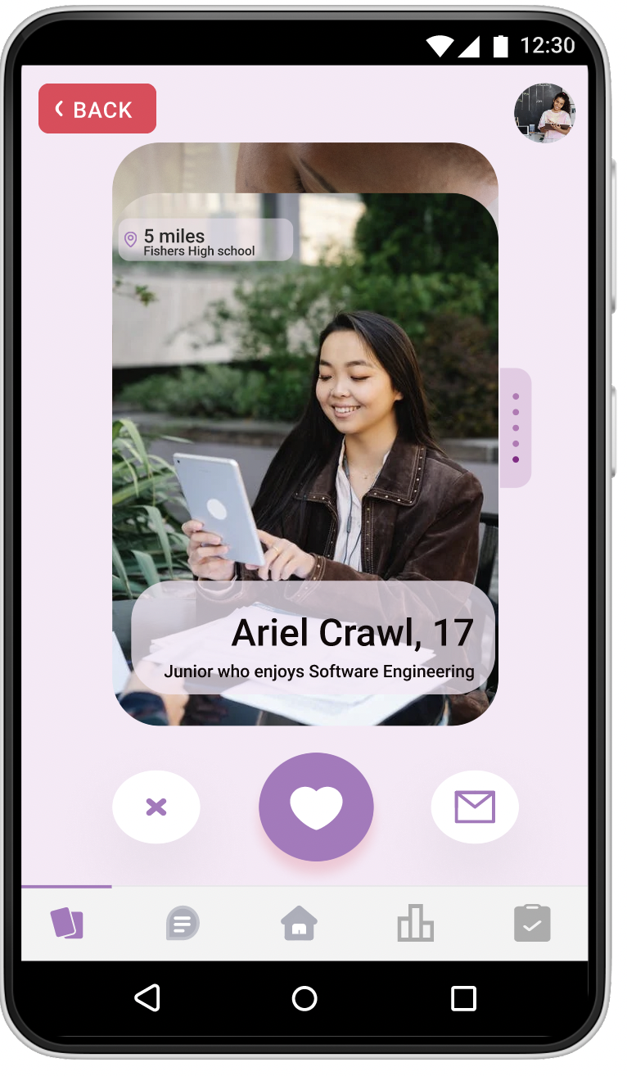
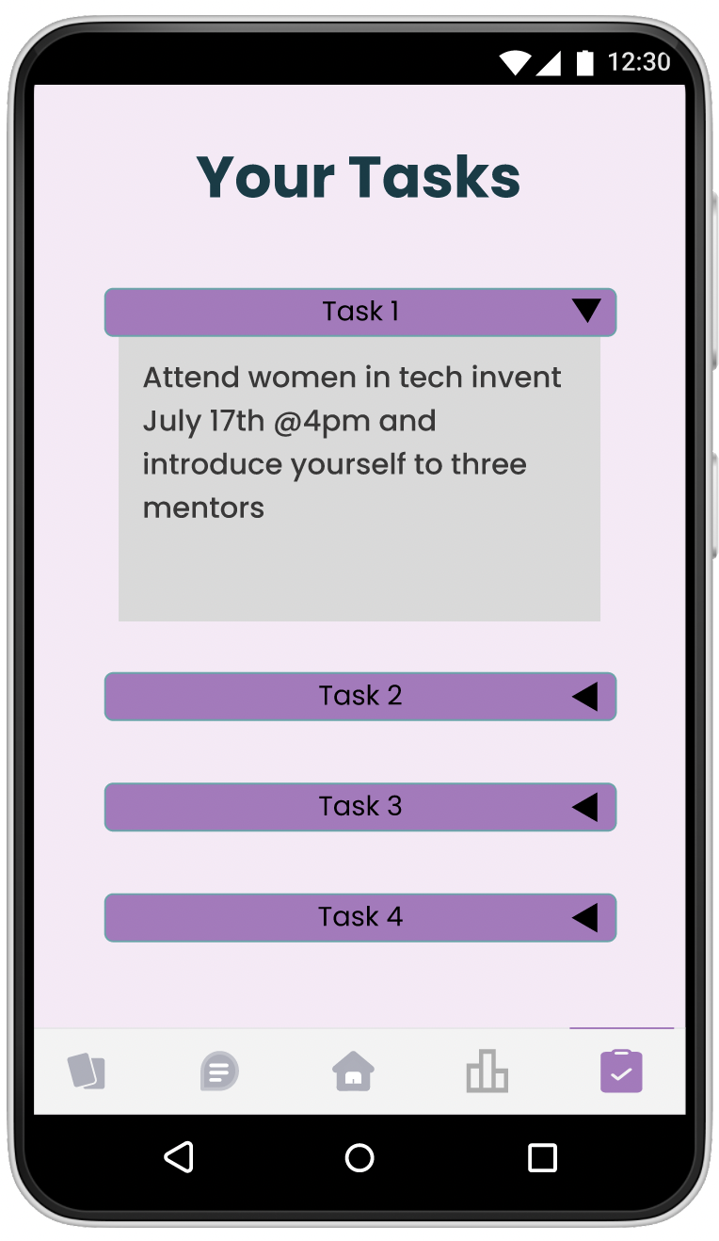
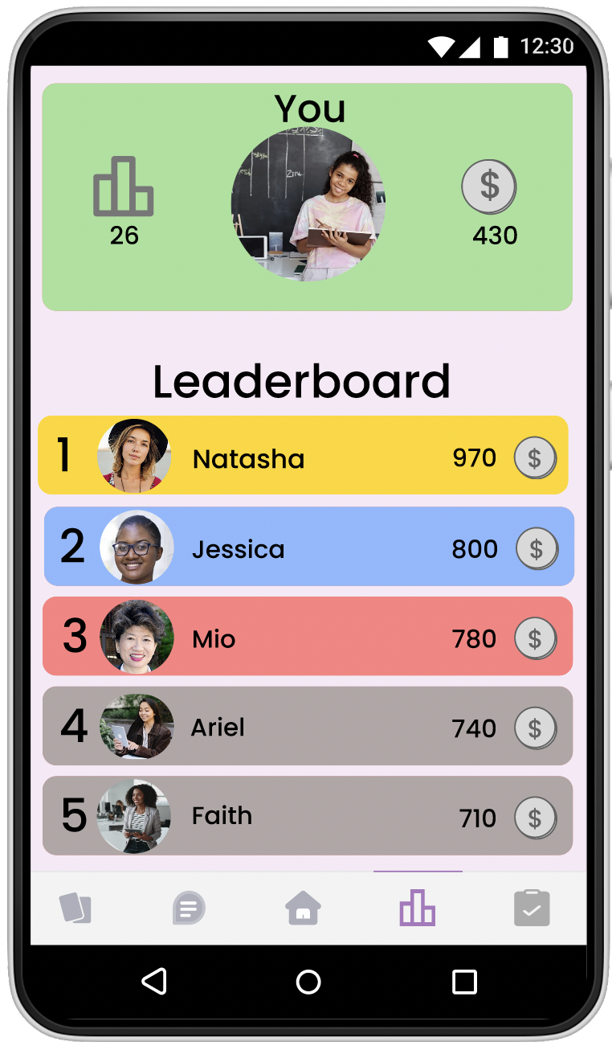
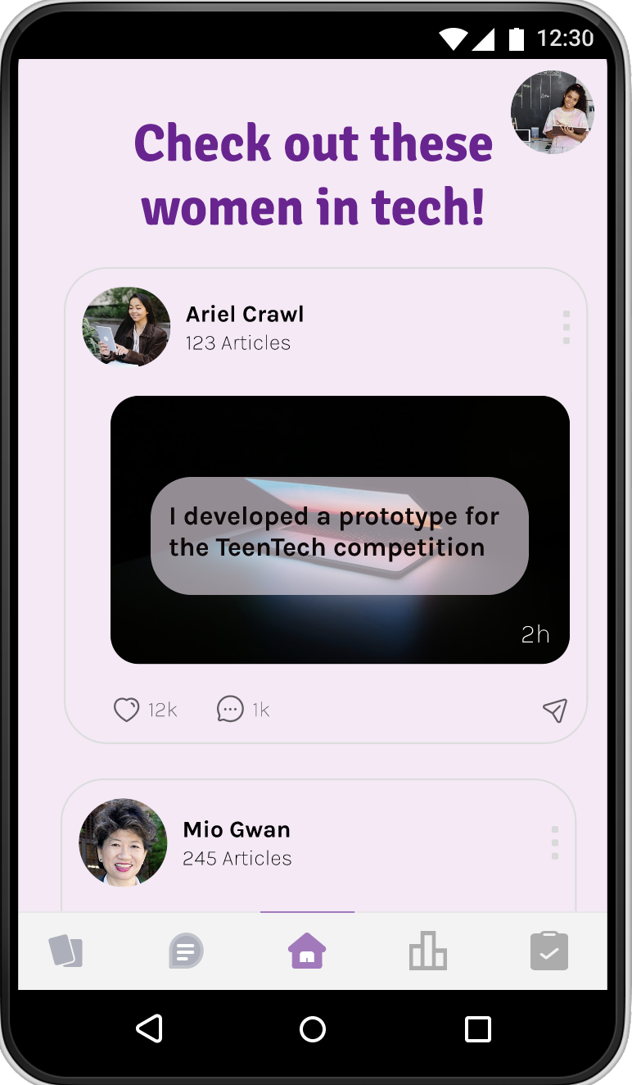
Notes:
jasmine

Slide 6


Partners
Reinforcement Tasks
-Mentorship & Assignments
-Job Shadow
-Support
-Tech experience
- Indy WiT
-WorkOne
-TechPoint
-High Schools
-Universities
Notes:
We want to spread the word about us in the best ways possible, so we plan to partner with Indy Women in Tech, TechPoint and WorkOne. Indy WiT is an organisation that helps and connects women interested in tech jobs, specifically minorities. WorkOne works to help people in need of jobs find jobs. Since these two organisations have the same passions as us, it just makes sense that we would work with them to get more high school minority girls interested in our app. In addition to this, we will be working with high school and university advisors and teachers, since we know that they are the ones with the biggest impact on students. Teacher-student bonds are unique and we know that in order to get students involved, we need to get teachers involved. Through our partnerships, we plan to get users connected with mentorships, job shadow opportunities, support and encouragement when they need it, and experience in the tech field that will ultimately give their resume a big boost and help them get the tech jobs they are interested in.

Slide 7


Market Validation
Empowering but encouraging these students and even giving them a little push to move forward is important in long run.
Group1
9-10th grade
Ariel Crawley
Community Engagement, Indy Women in Tech
Notes:
We wanted to know some thoughts from individuals with much more knowledge and experience in this than we have, so we talked to Ariel Crawley, an employee at Indy WiT who is involved with community engagement. She was totally on board with our idea and completely agreed that we were working on something important. She said that, “Empowering but encouraging these students and even giving them a little push to move forward is important in the long run.” Ariel really helped us enforce the idea that it is vital to get minority women involved in tech jobs early on so that they will see a place for themselves there and we will have more diversity in tech jobs in the future.

Slide 8
Forecasting
Expenses
-Initial-$2,000
-Ongoing-$850
-Monthly Customer Acquisition Cost- $1550
~$30,000
Funding
-Partner Sponsorships-$10,000
-Advertisements-$500
-Corporate Sponsorships-$5,000
-Grants-$10,000
Group1
9-10th grade
Notes:
Taking a look at our potential finances, we estimate that we will be paying about $30,000 per year to start the app and keep it running. We looked at the initial program and labour fees, which would go to about $2000. Moving on to our monthly expenses, labour and technology costs will come to about $850/month. Monthly marketing costs, which would include digital advertising and in-person events and swag, come to about $1550/month, assuming 5% of people who see our social media posts interact with them and click on them, and assuming we are charged $1/click. With a little extra financial wiggle room for any other expenses, that comes to about 30,000 a year. We intend to use any sponsorships, advertisements, and any grants we may receive to afford this $30,000/year.

Slide 9

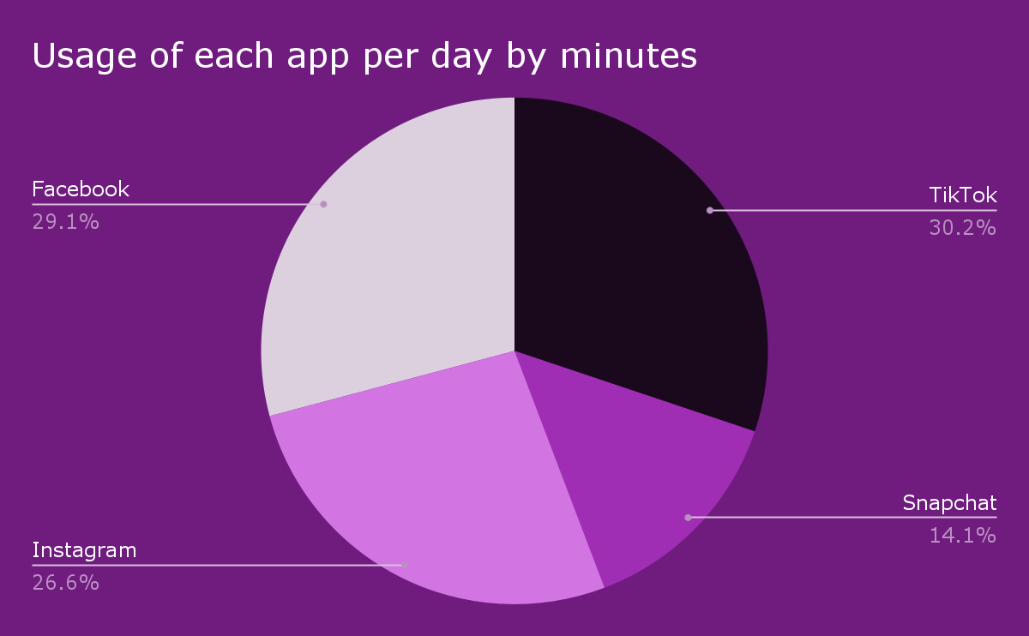





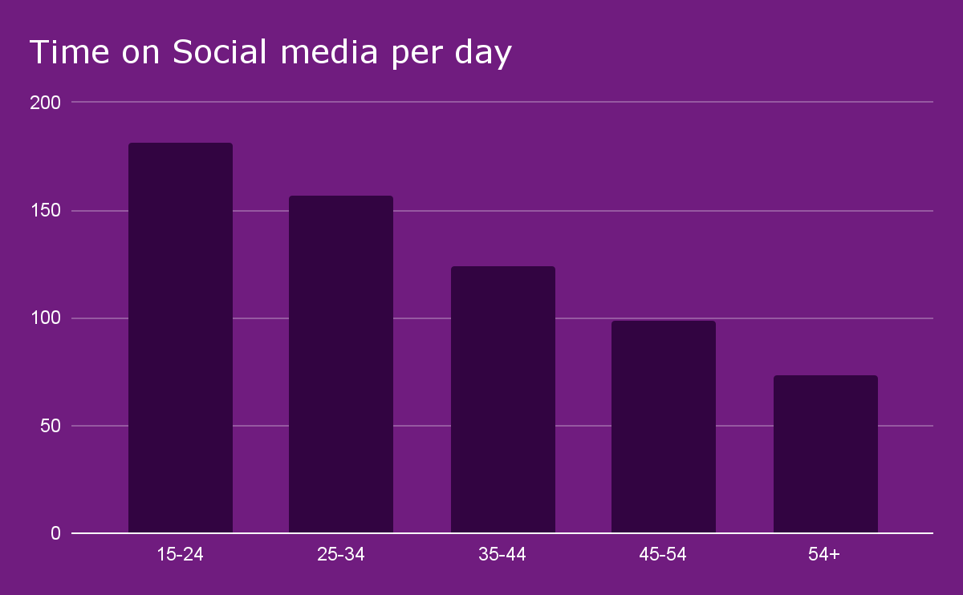
Marketing
Use of social media and school fairs
Source: Review42.com and ABC news
Notes:
Our best sources of marketing will be social media and school events, since those are the two things that all minority high school girls as well as their teachers have in common. According to ABC news, most high school girls report spending more than 3 hours a day on their phone, and specifically on social media. We can use this to our advantage! TikTok, Snapchat, Facebook, and Instagram algorithms allow users to see advertisements and posts related to things they like and are interested in, in addition to related to their demographic. We will be doing social media advertisements, aiming them towards high school age minority girls (age 15-18) to make sure they see us. We also want to attend school college and job fairs with some flyers, free food, and swag to get students and even teachers as excited as we are about Yumi.

Slide 10
App Features
Algorithm
Leaderboard
Security
Customer support
Notes:
Security - Talk about encrypting usernames and passwords and storing them through database tools such as SQL. Additionally, we will also use a double authentication software called Duo because your security is one of our top concerns that we understand. Through Duo, we will send a push verification to ur phone to confirm so that we can know it is actually you logging in.
Algorithms - Through the use of unique Algorithms with the help of machine learning we can help connect Yumi learn people’s personalities and match them with the best mentor mentee relationship based on the results from the questionnaire quizzes given by the users and the mentors.
Support - At your convinence we also have a 24/7 customer support group to help enable and guide you through dreams and help better you lives and give you more opportunities.

